Slide 1
HISTO BOT
TEAM-4
SK.NAZIYA
Y.NIKITHA
G.SRAVANI

Slide 2


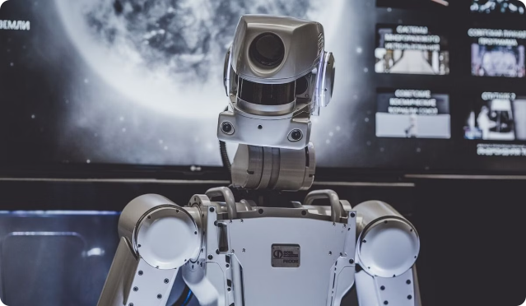
Histo Chatbot
Histo chatbot is an AI-powered tool designed to assist users in learning about historical events. It utilizes natural language processing to engage users in conversation about various historical topics. The chatbot is accessible through messaging platforms, websites, and mobile applications.

Slide 3



Introduction
AI-Powered
Histo chatbot is an AI-powered tool designed to assist users in learning about historical events.
Natural Language Processing
It utilizes natural language processing to engage users in conversation about various historical topics.
Accessibility
The chatbot is accessible through messaging platforms, websites, and mobile applications.

Slide 4

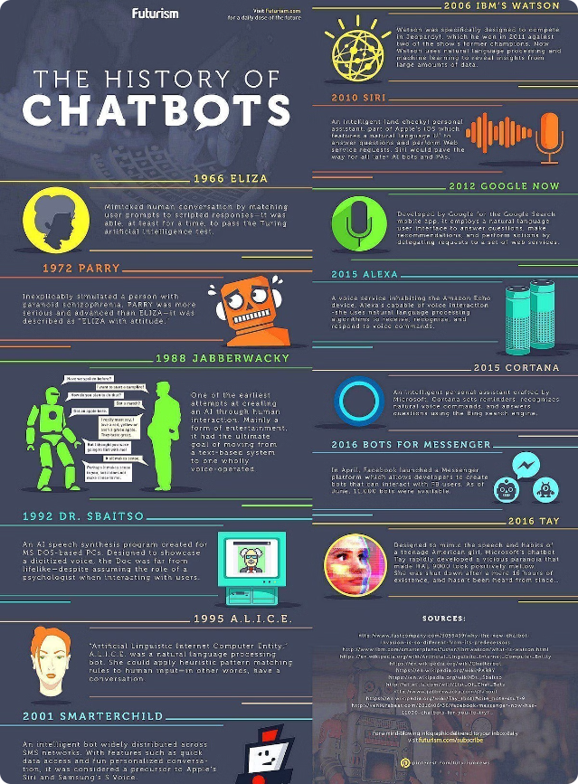
Features
1
Detailed Information
Histo chatbot can provide detailed information on specific historical events, figures, and periods.
2
Real-Time Responses
Users can ask questions and receive accurate and relevant historical facts in real-time.
3
Resource Recommendations
The chatbot can recommend further reading materials and resources based on user preferences.

Slide 5

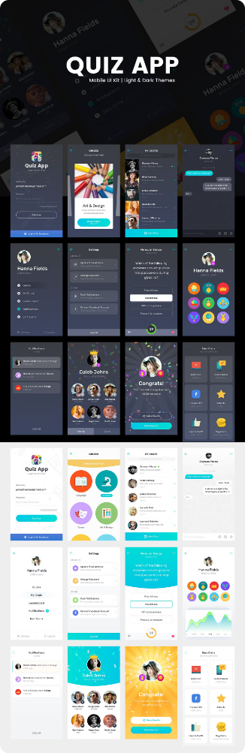
Interactive Learning
1
Interactive Quizzes & Games
Histo chatbot offers interactive quizzes and games to test users' knowledge of history.
2
Simulated Conversations
Users can engage in simulated historical conversations with virtual historical figures.
3
Personalized Learning
The chatbot adapts its responses based on user interactions to provide a personalized learning experience.

Slide 6

Multilingual Support
.Global Reach
Seamless Language Switching
Inclusive Access
Histo chatbot is available in multiple languages, expanding its reach to users worldwide.
Users can effortlessly switch between languages to access historical information in their preferred language.
The chatbot's multilingual functionality enhances accessibility and inclusivity, empowering users from diverse linguistic backgrounds.

Slide 7





Integration with Educational Platform
Supplement History Lessons
Histo chatbot can be integrated with educational platforms to supplement history lessons and coursework.
Enhanced Student Engagement
Teachers can incorporate the chatbot into their curriculum to enhance student engagement and understanding of historical topics.
Interactive Learning Experiences
The chatbot's integration with educational platforms promotes interactive and immersive learning experiences.

Slide 8


Real-Time Updates
Regular Updates
Histo chatbot is regularly updated with new historical information and events to provide users with the latest insights.
Current Historical Discoveries
Users can stay informed about current historical discoveries and developments through the chatbot.
Accurate & Up-to-Date Content
The chatbot's real-time updates ensure that users receive accurate and up-to-date historical content.

Slide 9


Privacy and Security
1
User Privacy
Histo chatbot prioritizes user privacy and data security to ensure a safe browsing experience.
2
Data Encryption
User data is encrypted and protected to prevent unauthorized access or misuse.
3
Privacy Guidelines
The chatbot adheres to strict privacy guidelines and regulations to safeguard user information.

Slide 10

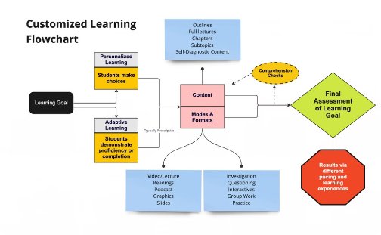
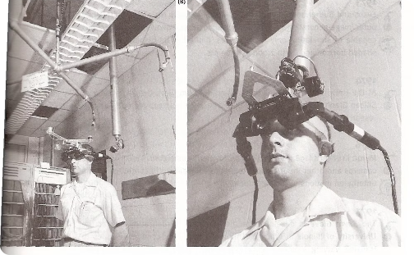
Future Developments
Enhanced Interactivity
Personalized Learning Paths
Virtual Reality Integration
Histo chatbot is continuously evolving with advancements in AI technology and historical research.
Future developments may include enhanced interactivity, personalized learning paths, and virtual reality integration.
The chatbot's future iterations aim to provide users with an immersive and engaging historical learning experience.

Slide 11



User Feedback and Improvement
User Feedback Collection
Improvement & Evolution
Continuous Feedback Loops
Histo chatbot collects user feedback to enhance its performance and user experience.
User suggestions and comments are utilized to improve the chatbot's responses and functionalities.
Continuous feedback loops enable the chatbot to evolve and better serve its users over time.

Slide 12
THANK YOU

